Slide 1
Video Based session
Stella Liebeck

Slide 2
In today’s session we will:
Listen and answer questions based on a video
Tell a story
Write an email of complaint and requesting something

Slide 3
Have you ever been to McDonald’s?
What’s the worst thing that can happen at a McDonald’s restaurant?

Slide 4
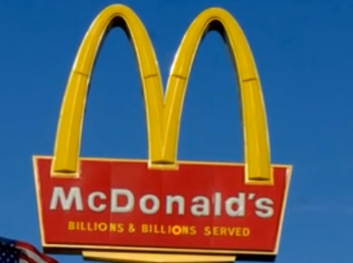
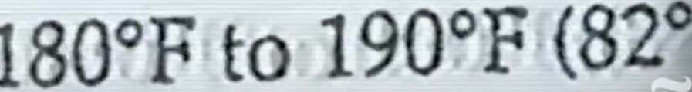
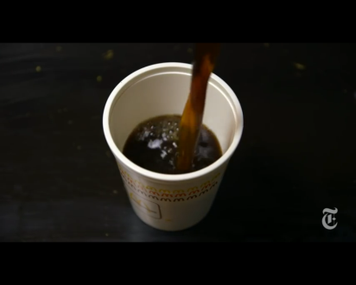
Look at the key words and pictures below. Try to make a story about what happened.
Stella dangerous product
Grandson
Car seat 3rd degree burns
bullying frivolous lawsuit
Some numbers
16% 10.000 dollars

Slide 5
Now you will watch the video. Try to find answers to the following questions.
Where was Stella from?
Who did she sue and why?
What happened after the story went to the media?
How much money did Stella end up receiving?
Why did Stella feel bullied?
Did McDonald’s change the product’s temperature?

Slide 6
Answers
1. Albuquerque.
2. McDonald’s/ she wanted them to pay for her hospital bills
3. The media focused on the money she was going to get.
4. Initially $2.7 million (suggested) but in reality less than $500.000.
5. She felt bullied because the media presented her as someone who was interested in the money.
6. Yes.

Slide 7
Discuss: What happened in the story? Were your predictions about the story correct?

Slide 8
Follow up questions
Why was this story so misunderstood?
What are your thoughts on the way the media approached this story?
If this happened to you, would you have taken the same actions as Stella? Why/ why not?

Slide 9
Imagine you are Stella. Email McDonald’s and tell them what happened to you and ask them to cover your medical bills.

