Slide 1
Travelling

Slide 2
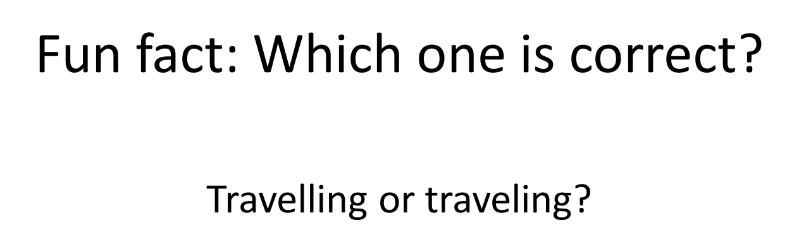

Slide 3








Can you name the following means of transport? Which one do you prefer to use? Why? Discuss with a partner.

Slide 4
In groups try to think of as many words/ phrases related to these means of transport.
Group A
Bike, Bus, taxi
Group B
train, plane, van,
Group C
lorry, ship, tube,
Group D
tram, Motorbike, car
E.g.. Plane: airport, e-ticket, passengers

Slide 5
Give a mini presentation about how you went from your house to here using vocabulary from the previous slides/ your group work.

Slide 6
Intensive listening:
Dictogloss
Your teacher is going to read a short text about one way to travel without spending money. Make notes of what you hear and then try to reconstruct the text.

Slide 7
Answer
Seek out travel grants
Believe it or not, some organisations exist with the sole purpose of funding travel. To cash in on this generosity, you’ll need to present a clear, considered plan and persuade a board of people that your trip is worthwhile. Many organisations value trips that will enhance personal or cultural development, but each has its own specifications and criteria. The SPRET educational trust caters specifically for students based in certain areas, whereas UNESCO and the UN both offer more general funding to travellers.
Taken from: http://www.telegraph.co.uk/education/universityeducation/student-life/9764605/University-travel-10-ways-students-can-globe-trot-for-free.html

Slide 8
You will watch a video of a student, Lauren, who travels around China. Listen carefully and answer the following questions.

Slide 9
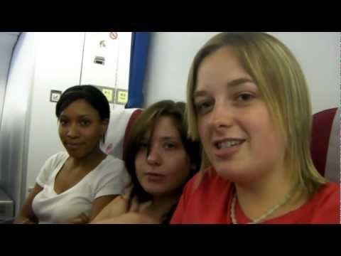
Link: https://www.youtube.com/watch?v=hrqQhMfJ3Jw

Slide 10
Questions (2 slides)
1. What is Lauren studying?
2. What is the date she left the UK?
3. How big is the university campus (6/ 60/600 hectares)?
4.What does Lauren say about her homestay visit?
5. How old were Tammy’s students ?

Slide 11
6. What did they do on the 1st of July?
7. What was the date of their last day of lectures?
8. When did they go to the Great Wall?
9. When did they leave?
10. How long was the flight back to London?

Slide 12
Answers
Applied drama
15th June
600
In the beginning she felt nervous, but she really enjoyed it.
8-9 year olds
They went food shopping
The last day of lectures was the 8th of July.
11th July
30th June
13 hours

Slide 13
Reflecting
How did you do today? How satisfied are you with your listening activities? How did you do in your speaking tasks? What do you need to work on? Discuss with your partner.

